Slide 1

Health Psychology:
Introduction
Assoc Prof Jason Landon jlandon@aut.ac.nz: AA70

Slide 2
Welcome to Health Psychology
Hope you enjoy the paper – variously taught by me, Char (paper leader), Claire, Jodie, and Grace
The course – an introduction to Health Psychology
Three assessments:
  Test – 16 August
  Written Assessment – 27 September
  Exam – TBA

Slide 3

Timetable
Already changed! Keep an eye on Blackboard

Slide 4
A bit about me, very briefly
Grew up in Puni, rural area west of Pukekohe.
  Ko Pukekohe te puke te rū nei taku ngākau
  Ko Pauanui te tātahi e mahea nei aku māharahara
  In Auckland/Tamaki Makaurau 28 years, two children, one dog, one cat.

Slide 5
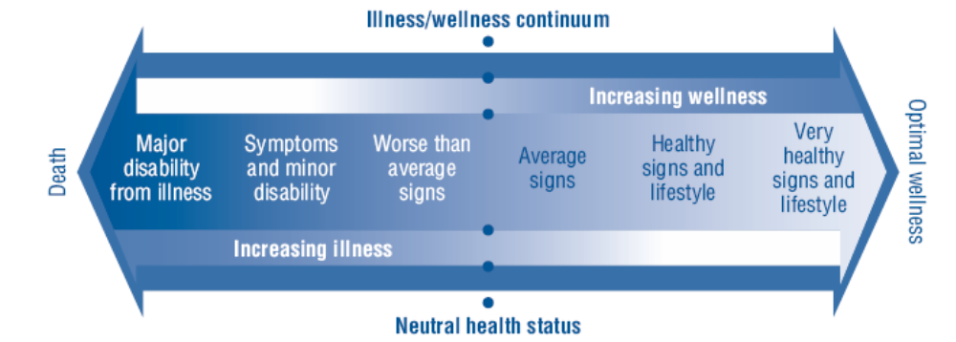
World Health Organization Definition of Health (1948)
“A complete state of physical, mental, and social well-being and not merely the absence of disease and infirmity.”
Notes:
Two very important distinctions in this definition: 1) One is that health embraces a state of wellness and is not simply the absence of illness (i.e., health promotion); and 2) the other is that health is not something that is just at the physical level of cells, muscles, etc. but also covers mental and social status. This broader definition of health is referred to as wellness.
We are all pretty familiar with what we mean by physical health, but what do we mean by mental and social well-being? Mental includes absence of mental illness and the promotion of optimism, happiness, love, and intimacy. Social health may include adequate social supports. However, the latter is also sometimes though of as a factor that influences health status. The WHO did not define what they meant by social well-being. Others have developed various definitions. One is that social well-being is the ability to function satisfactorily in social roles such as work, family, and recreation.

Slide 6
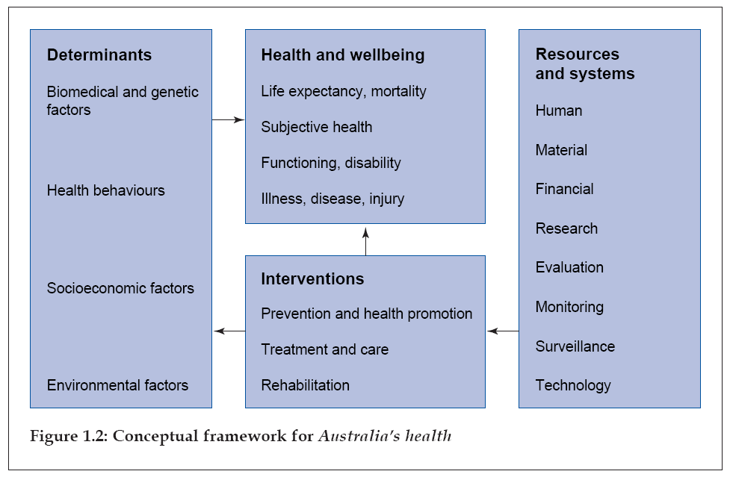

Slide 7
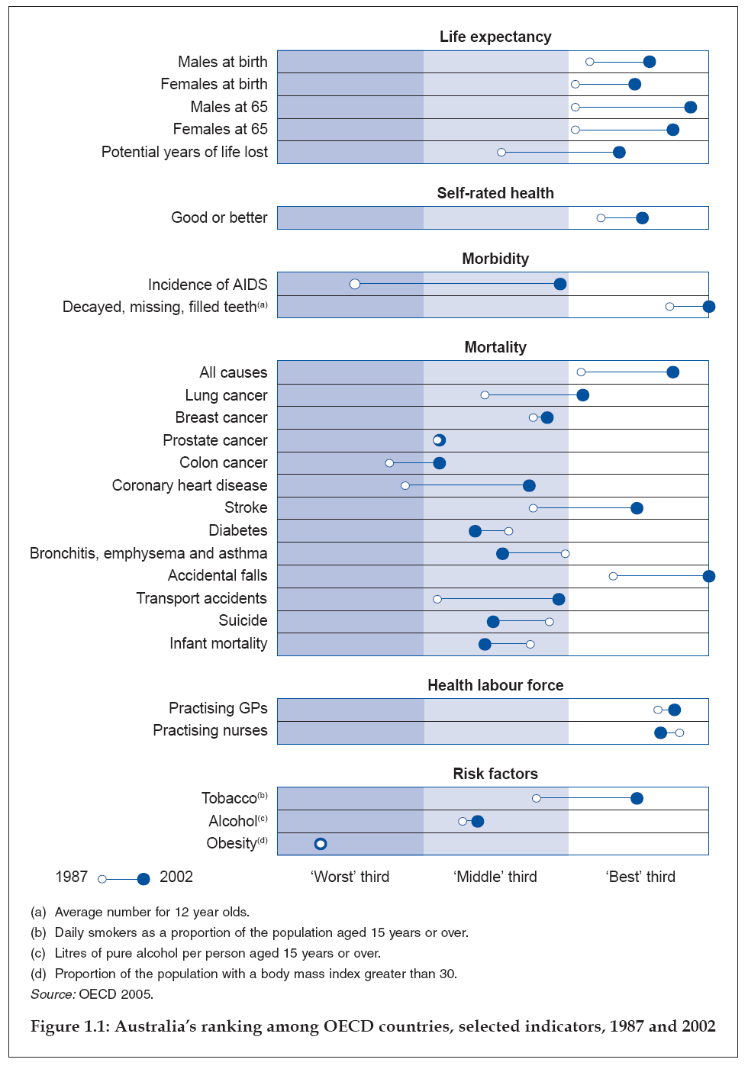

Slide 8
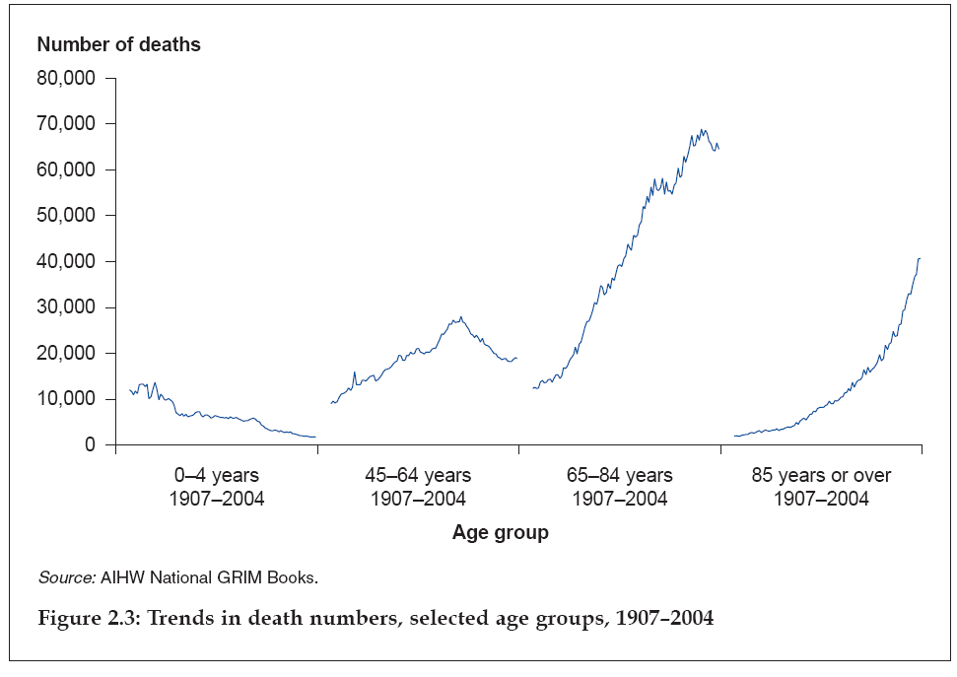
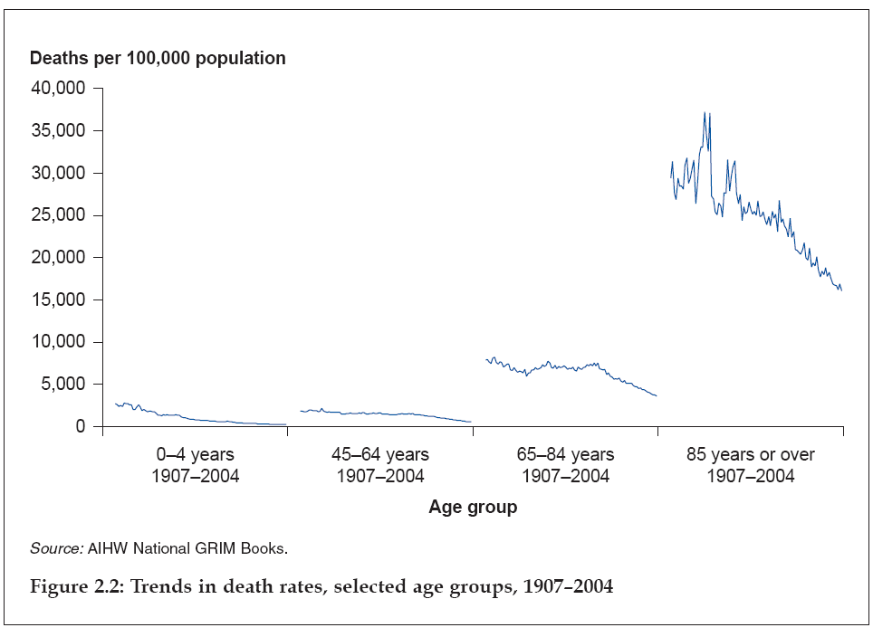

Slide 9
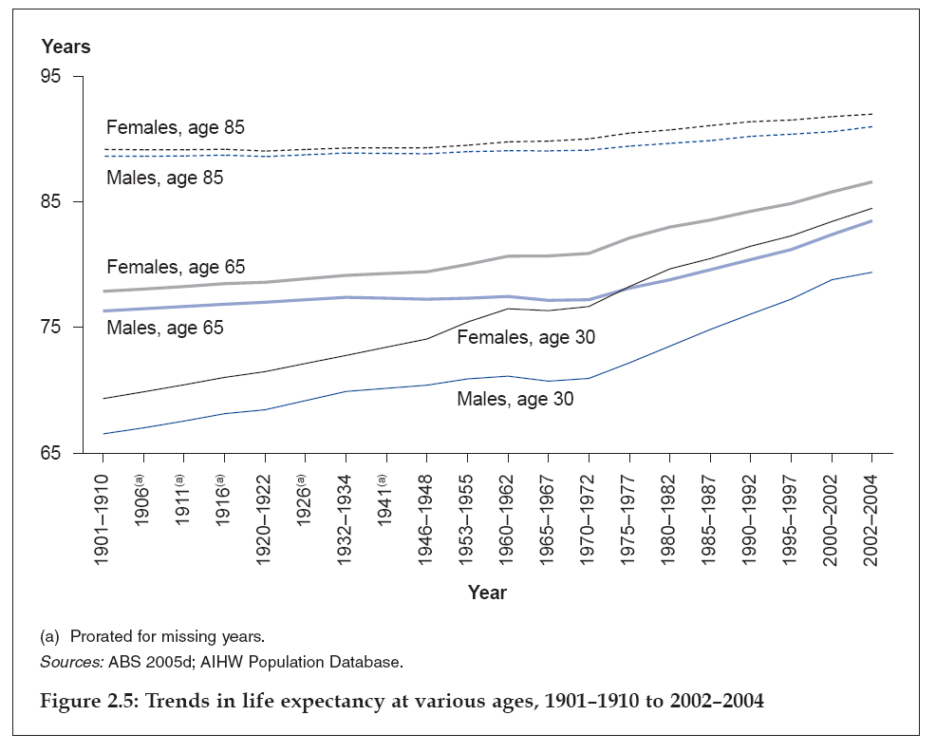
@ birth 69 & 72 for Indigenous Australians
@ birth 79 & 83 for non-indigenous Australians

Slide 10
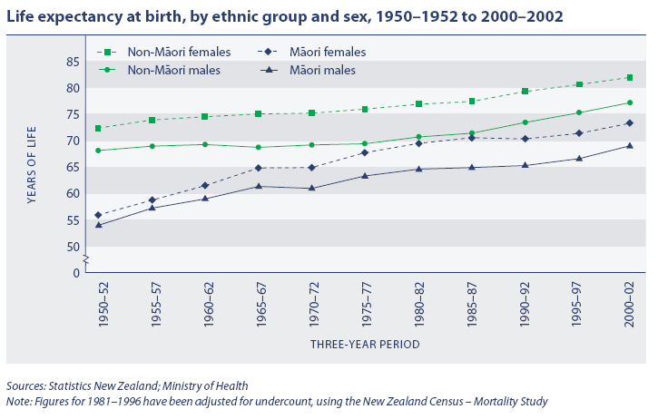

Slide 11
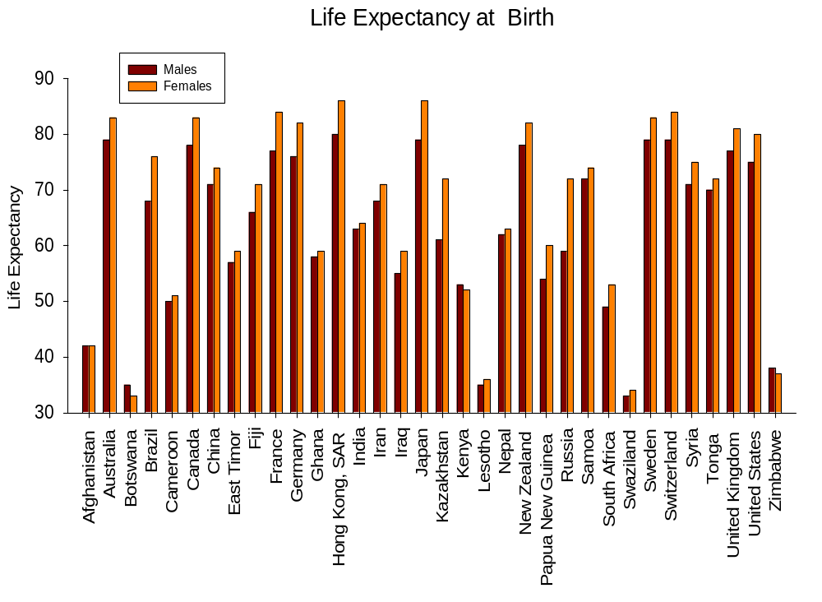
NZ

Slide 12
How to live longer
Kirkwood (1994) and Smith (1993) have offered the following advice if you wish to maximise your life expectancy:
  Be female
  Don’t smoke
  Be a light drinker
  Be Japanese
  Enjoy sex
They do concede that not all these options were open to everyone….

Slide 13
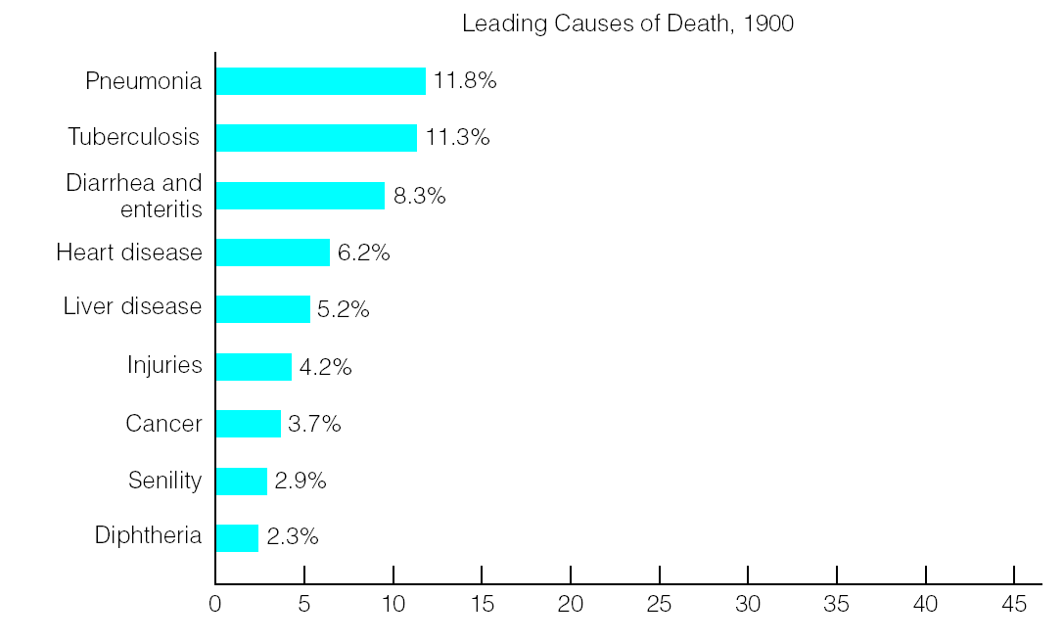
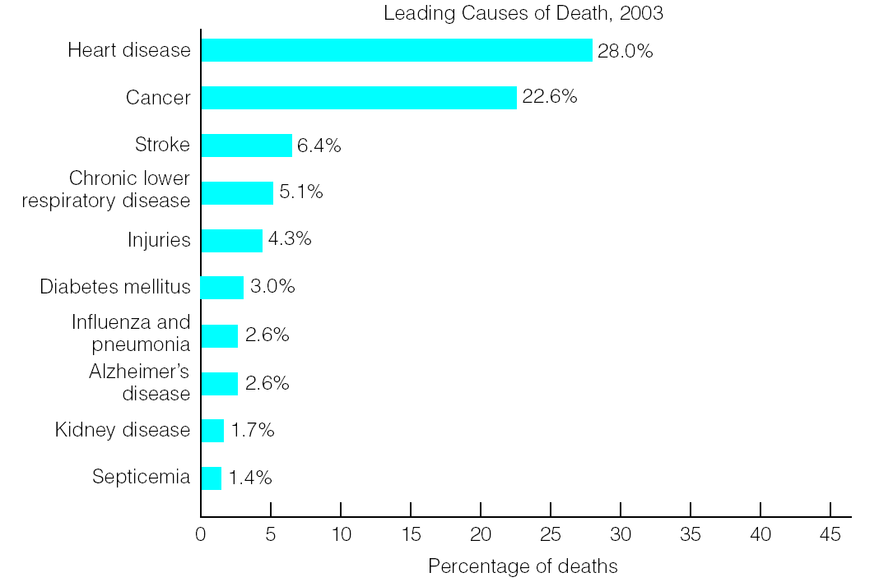
What do we die of?

Slide 14
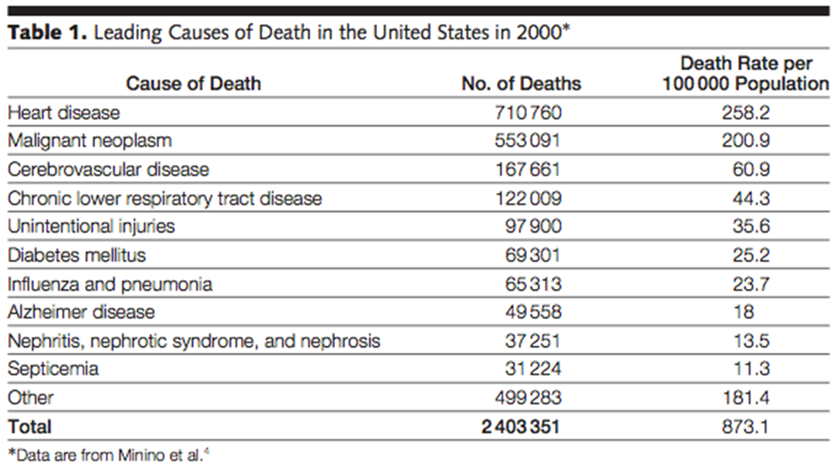
Mokdad et al., 2004

Slide 15
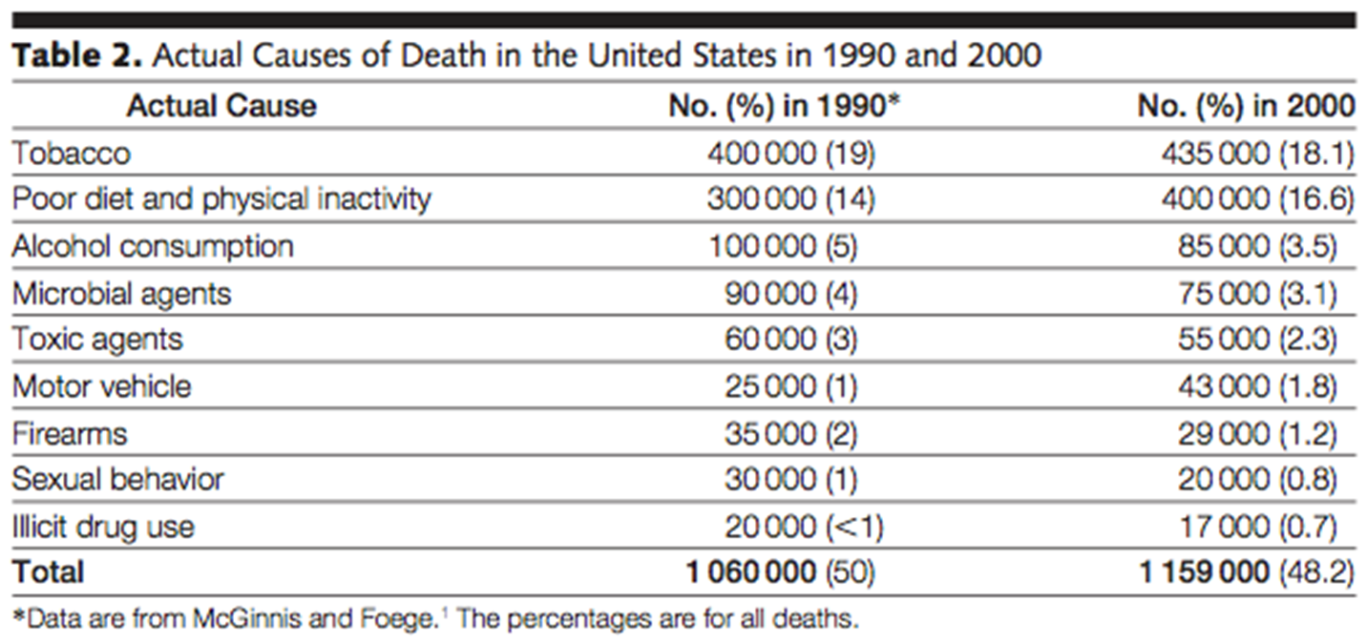
Mokdad et al., 2004

Slide 16
History: The biomedical model
Admittedly oversimplified…
What causes illness?
  Chemical imbalances, bacteria, viruses, genetic predispositions
  Syndromes expressed as signs or symptoms are associated with lesions or underlying pathology
Who is responsible for illness?
  No-one – an individual is a victim of an external force
How should illness be treated?
  Vaccination, medication, surgery
  Pathology is focus of treatment and research
  Interventions made to eradicate lesion, or prevent its pathogenesis

Slide 17
History: The biomedical model
Who is responsible for treatment?
  The medical profession
What is the relationship between health and illness?
  Illness and health are qualitatively different: You are either ill or healthy.
What is the role of psychology?
  There are psychological consequences, but not causes.

Slide 18
History: Psychology
Across time an increasing role for and understanding of psychology in the causes and treatment of illnesses
Psychosomatic medicine
  Developed on Freud’s look at the mind and illness – ‘hysterical paralysis’ – paralysed limbs with no physical cause… his take, repressed expressions and feelings manifested as a physical problem
Behavioural medicine
  Schwartz & Weiss (1977), Polerleau & Brady (1979) – behavioual sciences focused on health care, treatment and illness prevention
  Behaviour therapy and modification, evaluation and treatment – focus on prevention was important and novel (departure from biomedical approach) – psychological issues are of interest when they contribute to development (or not) of illness
  Scientific, and challenged the separation of mind and body
Behavioural health
  Explicit focus on prevention and health maintenance

Slide 19
What is Health Psychology?
Psychology is both an academic and applied discipline involving the scientific study of behaviour and mental processes.
Classic definition: ‘… the aggregate of the specific educational, scientific and professional contribution of the discipline of psychology to the promotion and maintenance of health, the prevention and treatment of illness, the identification of aetiologic and diagnostic correlates of health, illness and related dysfunction’ (Matarazzo, 1980)
Pragmatic definition: Health psychology is the study of psychological processes that influence health, illness and health care

Slide 20
Psychological Processes in Who?
People who receive health care
  Patients: anyone interacting with a health care professional or service
  Users: perceived presence of symptoms driving health care use
  Consumers: active, and proactive, care seeking by the asymptomatic
People who provide health care
  Providers: professional responsibility to provide care directly to patient
  Carers: as above, but without professional responsibility
People who organise health care
  Purchasers / managers: who fund and evaluate local service against benchmark quality indicator, e.g. treatment targets
  Policy- / Decision-makers: set national-level quality indicators, provide clinical guidance and allocate financial resources

Slide 21
The health psychology approach
Who is responsible for treatment?
  Individuals are also responsible for their treatment.
What is the relationship between health and illness?
  Illness and health are not qualitatively different: There are different degrees of each, and they are both ends of a continuum.
    Or probably a multi-dimensional continuum
What is the role of psychology in illness?
  There are not only psychological consequences, but psychological factors can be contributing to health at all stages: illness onset, help-seeking, illness adaptation, illness progression, and health outcomes.

Slide 22
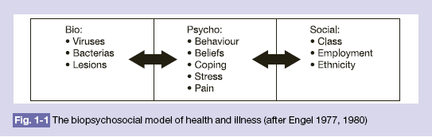
The biopsychosocial model (Engel, 1980)
    adopts a holistic approach;
    adopts a systems approach of interrelated components nested within larger components

Slide 23

Biopsychosocial Model
Psychological component
  Behaviour (adoption and maintenance)
  Emotional (feelings)
  Cognition (thoughts, beliefs, and attitudes)
  Personality – characteristic ways of thinking, behaving, and feeling
Notes:
Behaviour – how do we get someone to adopt a new behaviour and maintain this behaviour. Learning theories have contributed to this topic (e.g., social learning theory, conditioning).
Emotion – subjective feeling feeling states.
Cognition – can influence risk perception, health risk appraisal, health beliefs such as locus of control, self-efficacy. Schemas are categorical beliefs formed from early experiences (e.g., I am unlovable. I am strong. I am weak.)
Personality reflects characteristics ways of thinking and believing and is thought to be shaped by temperament (i.e., biological propensity toward certain feeling states like shyness) and early experiences (e.g., security, nurturance, love, limit setting, unrelenting standards, etc.).

Slide 24
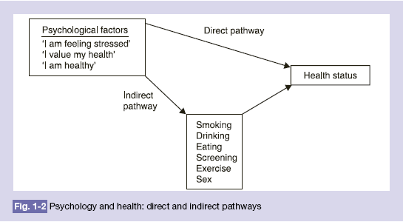
The dual process model
Much more at play ‘direct pathway’- psychoneuroimmunology

Slide 25
Nerves
Hormones
Psych Processes
Nervous System: Physiological
Reactivity
Chronic
Stress
Psychological
Appraisal
GI: IBS, ulcers
Psych: cognitive decline, morbidity
Sensitivity - more severe
RS: impotence, amenorrhea
Res: asthma, hyperventilation
Salient
Event
Cardiovascular System
Endocrine System
Immune System
Essential
Hypertension
Metabolic
dysfunction
Lowered
immunity
Hypervigilance - more events
Physical and Psychological
Health Status

Slide 26
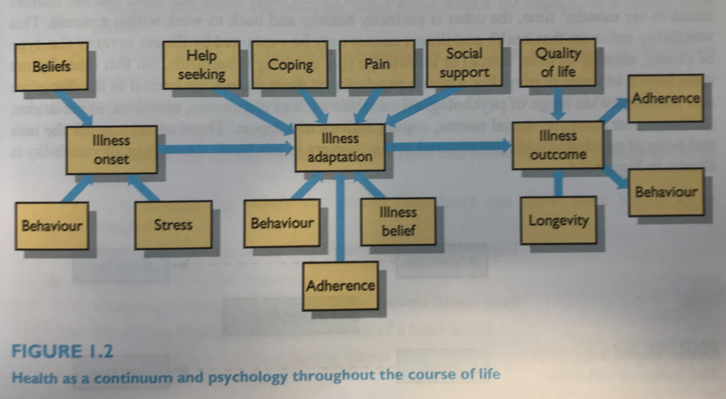
Psychology and Health

Slide 27
What are the aims of health psychology?
1. To understand, explain, develop and test theory
  Why do some people smoke even though they know the risks?
  How does behaviour relate to CHD?
  How does stress relate to illness?
  How do people cope with illness?
  Why do some people go to the doctor when nothing is wrong whilst others avoid going even though they have serious symptoms?
  The role of behaviour in the cause, onset, progression and/or cure of an illness
  Remember – psychology as the science of behaviour aims to describe, explain, predict and control behaviour

Slide 28
The aims of health psychology (cont.)
2. To put theory into practice
  How can behaviours be predicted and changed?
  How can illness be prevented?
  How can the consequences of illness be minimised?
  How can health professionals improve their management of patients?
  Promote healthy behaviour, change unhealthy behaviour, support improved coping, resilience and prevent (or ameliorate impact) illness

Slide 29
But…
While sometimes the medical model acknowledges broader causation…
Even the biopsychosocial model focuses on sickness and its causes
  Psychological and environmental aetiology, physiological lesions.
  Disease categories, lesion characteristics, risk factors
Current climate demands a focus on outcomes measures by physicians
  Blood chemistry, physical characteristics etc
  As opposed to ‘behavioural’ ones – longevity, health-related quality of life, symptomatic complaints, day-to-day functioning

Slide 30
Kaplan (1990) an alternative
“Biologicalisation”
  Studies criticised if no examination of blood chemistry, cholesterol, blood pressure, immune response, or use of disease categories
Equated by many as a more ‘scientific approach’
  Biological measures viewed as pure, more reliable, more valid
Just because we can measure something, doesn’t mean the measure is useful
  By now you should know a bit about reliability and validity!
  And that reliability does not mean validity.

Slide 31
Blood Pressure
Blood pressure – very important
Linked to behavioural outcomes – premature mortality or behavioural dysfunction from coronary heart disease or stroke…
  Important because of that… blood pressure itself is not an important health outcome
Assumption (expectation) made that biological measures are reliable.
  Medical scientists not always good at assessing reliability – yet feel happy criticising psychological/behavioural measures as not being reliable
    Perception that psychology is soft…

Slide 32
Blood Pressure
Get yourself a blood pressure monitor and do a little experiment
Conventional instruments have poor test-retest reliability.
  Misclassification, incorrect diagnoses, labeling etc
Sources of error
  Misreading (biased towards 0), time sampling, and the obvious situational factors (white coat hypertension)
  Also plagued by low reliability – blood cholesterol, glucose, and others…

Slide 33

Deaths – specific vs general causes
Given issues with disease process, some turn to ultimate behavioural outcome – death
Some focus on medical cause of death, others on the behavioural outcome death without reference to medical cause… often confused
Classic example
  Steering Committee of the Physicians’ Health Study Research Group (1988; 1989) – participants took aspirin (325 mg/day) or placebo to reduce deaths by myocardial infarction
  Significant reduction in these deaths, labeled “wonder drug”, cover of Newsweek magazine etc

Slide 34

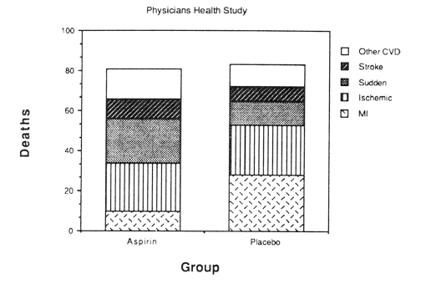
Deaths
Always useful to look at and think about the data… 22,000 randomised.

Slide 35
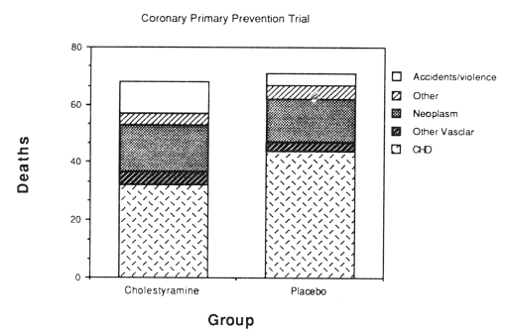
Deaths
Another one, this study involved a drug that lowered serum cholesterol (cholestyramine) – widely cited early on as crucial evidence for the importance of lowering blood cholesterol
Of 3800 men – 38 (2%) of placebo group died of CHD, and 30 (1.6%) of treatment group
  1% to 2% rule – 12% reduction in cholesterol 21% reduction in mortality!!!

Slide 36
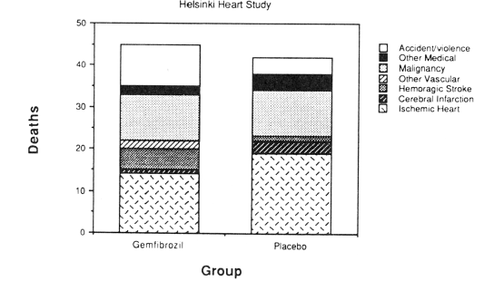
Deaths
Helsinki Heart Study – similar drug (gemfibrozil)
After 6 years, 19 of 2030 men in placebo group died of CHD, 14 of 2051 of treatment…
  Authors concluded 26% reduction in CHD deaths!!
Impressive!
  Authors took ratio (0.0068/0.0093 = 0.73) and subtracted from 1, or more simply 5/19… hmmmmmm
  Other ways of stating difference… 0.25% probably more appropriate (i.e., 0.68% of drug group died and 0.93% of placebo)
  Overall more in the drug group died…

Slide 37
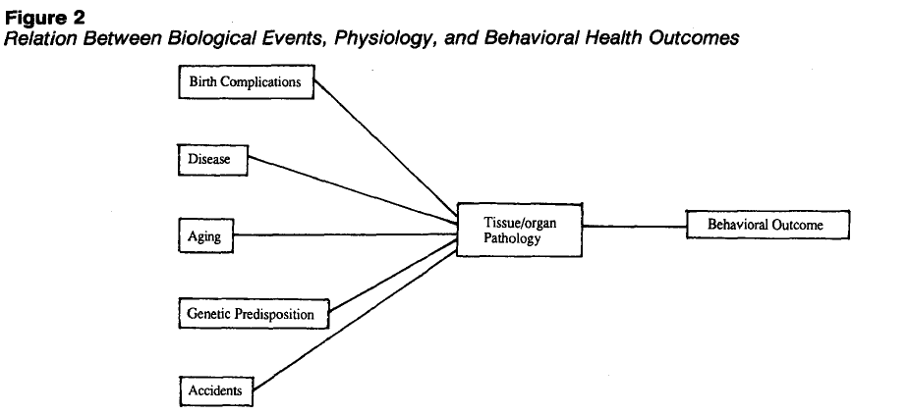

Kaplan’s model
Most have a biological measure on rightmost end – Kaplan argues behavioural outcome is fundamental, and of course can have effects to the left
Not to say an intervention at level of tissues or organs not valid – but interventions have importance because they have effects on behavioural outcomes.

Slide 38
Kaplan’s model
He argues that the traditional approach leads to focus on risk factors not outcomes…
Example (dated now, but the pattern will be familiar)
  Many epi studies have shown no relationship between coffee consumption and death due to CHD – in fact seems to be no effect on overall life expectancy
  But, studies have shown coffee increases LDL cholesterol and blood pressure
  So, recommendation to abstain from coffee… logical?
    If risk factors are your focus, yes, but are they?

Slide 39
Kaplan’s model
Two outcomes of importance
  Life expectancy
  Quality of Life or functioning along the way
  Biological and physical events are mediators, and affect individuals very differently
  Concern over cancer, blood pressure, cholesterol, etc might well in itself reduce life expectancy, or Quality of Life
    As we’ll see stress is bad, unquestionably
  A balancing act…

Slide 40
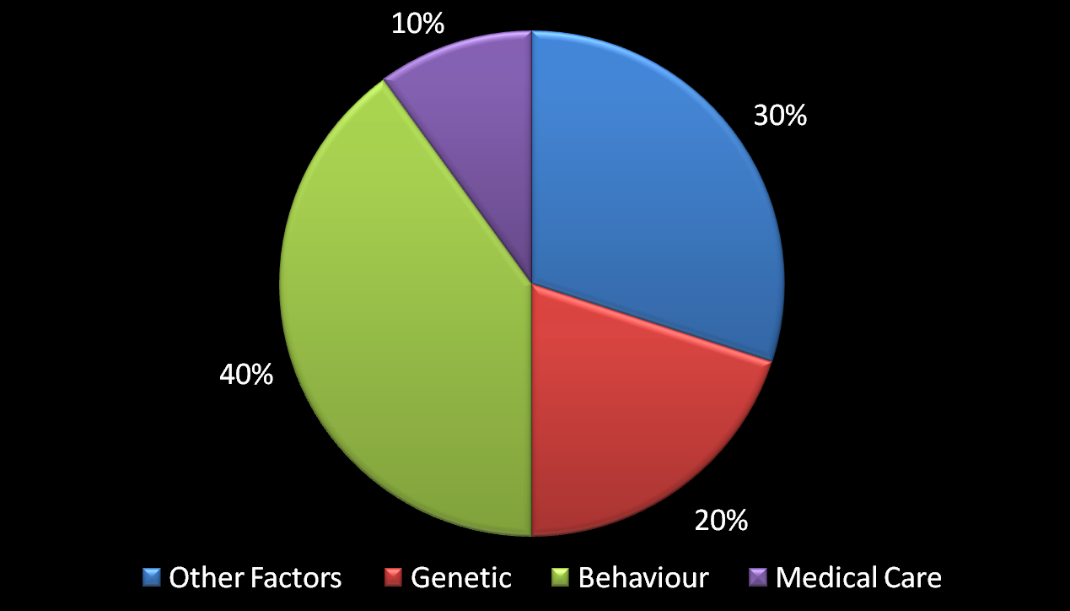
Estimated contributions of different factors to health status.
Kaplan, Sallis, & Patterson (1993)
Notes:
Kaplan, R.M., Sallis, Jr. J.F., & Patterson, T.L. (1993). Health and Human Behavior, New York: McGraw-Hill, Inc., page 9.
It would be much easier if there was one cause for a specific illness or disease, such as with tuberculosis and cholera. However, by far the majority of disease are not caused by just one causal factor. Think of heart disease and cancer. What factors contribute to the development of heart disease?
Many factors contribute to your health status, your vitality, and your resistance to illness. These include genetic factors, chronic illness, physique, physical fitness, diet, and many other health practices.

